Slide 1


Виконав:
Студент ФПМ, групи КВ-41
Горпинич-Радуженко Іван

Slide 2

 Operating system.
 Functions and components of OS.
 Types of OS.
 Process and a program.
 Real time operating system (RTOS).

Slide 3
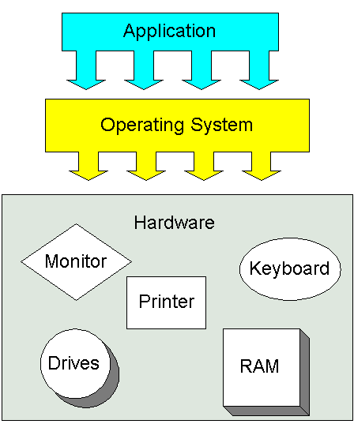
 An operating system
(OS) is a collection of software that manages computer hardware resources and provides common services for computer programs. The operating system is a vital component of the system software in a computer system. Application programs
usually operating function.
require an to
system

Slide 4

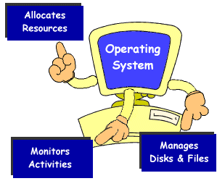
 Managing resources
 Providing a user interface
 Running applications
 Support for built in utility
programs.
 Control to the computer hardware

Slide 5

 Process Management
 Memory management
 I/O Device management
 File system
 Protection
 Network management
 Network services
 User Interface

Slide 6

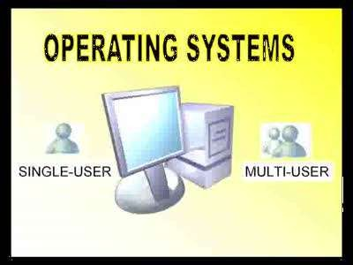
 Real time operating systems.
 Single user, Single Task
 Single user, Multi- tasking
 Multi user, Multi-tasking.

Slide 7

 Reliable.
 Operational at all times.
 Should coordinate and have good control of input and output operations and the devices on which they are performed.
 Enhance time sharing.

Slide 8
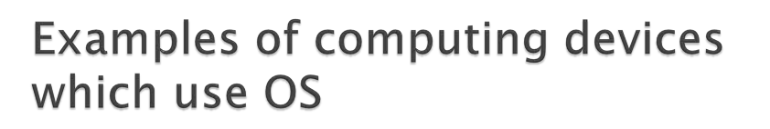
 Computers
 Mobile phones
 3d televisions
 Video game
 ATM
 Ticket Wending Machine

Slide 9
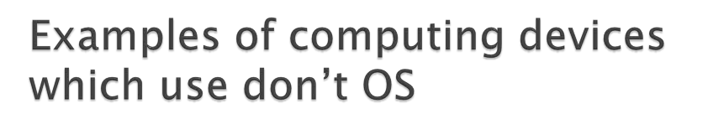
 Speed meters.
 Digital Watches.
 Micro ovens.
 Washing machines.
 Calculators.

Slide 10

 Easy to use
 User friendly
 Intermediate between all hardware's and software's of the system
 No need to know any technical languages
 Its the platform of all programs

Slide 11

 If any problems affected in OS, you may lose all the contents which have been stored already
 Unwanted user can use your own system

Slide 12

 A process invokes or initiates a program. It is an instance of a program that can be multiple and running the same application.
 Example:- Notepad is one program and can be opened twice.

Slide 13

 An operating system (OS) intended to serve real-time application requests
 An RTOS has an advanced algorithm for scheduling.

Slide 14

 Cooperative scheduling
 Preemptive scheduling
Rate-monotonic scheduling
Round-robin scheduling
Fixed priority pre-emptive scheduling, an implementation of preemptive time slicing
Fixed-Priority Scheduling with Deferred Preemption
Fixed-Priority Non-preemptive Scheduling
Critical section preemptive scheduling
Static time scheduling
 Earliest Deadline First approach
 Stochastic digraphs with multi-threaded graph traversal

Slide 15

 Running (executing on the CPU);
 Ready (ready to be executed);
 Blocked (waiting for an event, I/O for example).

Slide 16
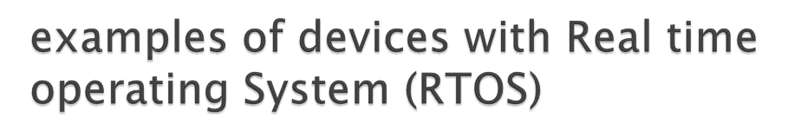
 LynxOS is mostly used in real-time embedded systems, in applications for avionics, aerospace, the military, industrial process control and telecommunications.
 Enea OSE is one of the most widely used RTOSes in the world. According to mobile analyst firm, VisionMobile, OSE has been deployed in over 1.75 billion mobile handsets, as of the end of June 2010. Enea OSE is shipped in hundreds of millions of mobile phones each year and over half of the world's 3G base stations.

Slide 17

The key difference between general-computing operating systems and real-time operating systems is the need for " deterministic " timing behaviour, general-computing non-real-time operating systems are often quite non-deterministic
Real-time operating systems are often uses in embedded solutions, that is, computing platforms that are within another device. While real-time operating systems are typically designed for and used with embedded systems.

Slide 18

World without Operating system is like
human without heart..

Slide 19


